Slide 1


Executive Summary Airline Safety
Madhavi Ghanta

Slide 2
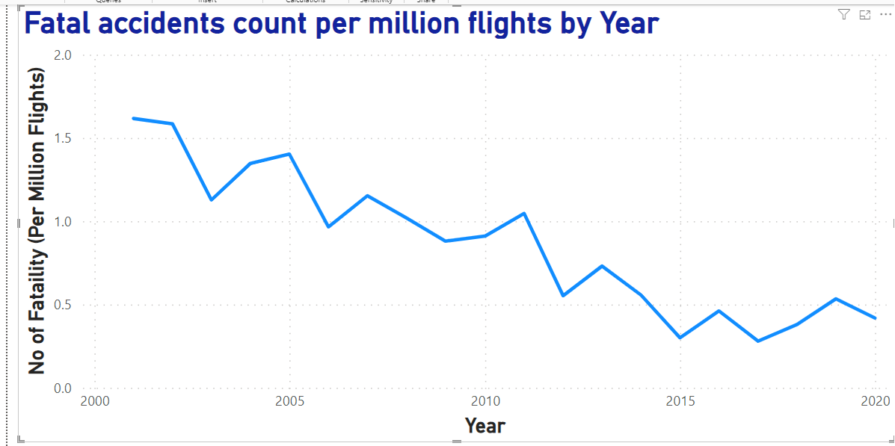
Yearly Fatality Comparisons
Airline fatalities have reduced over the last two decades
Clearly traveling by plane is a lot safer

Slide 3

US Auto Annual Safety Stats (1990-2019)
Average Miles Traveled:
2.8 Trillion
Average Fatal Crashes:
35,389
Average Fatalities:
39,186
Notes:
When conducting research, it is easy to go to one source: Wikipedia. However, you need to include a variety of sources in your research. Consider the following sources:
Who can I interview to get more information on the topic?
Is the topic current and will it be relevant to my audience?
What articles, blogs, and magazines may have something related to my topic?
Is there a YouTube video on the topic? If so, what is it about?
What images can I find related to the topic?

Slide 4
US Airline Annual Safety Stats (1990-2019)
Average Miles Traveled:
169 Million
Average Fatal Crashes:
1.6
Average Fatalities:
9
Notes:
When conducting research, it is easy to go to one source: Wikipedia. However, you need to include a variety of sources in your research. Consider the following sources:
Who can I interview to get more information on the topic?
Is the topic current and will it be relevant to my audience?
What articles, blogs, and magazines may have something related to my topic?
Is there a YouTube video on the topic? If so, what is it about?
What images can I find related to the topic?

Slide 5
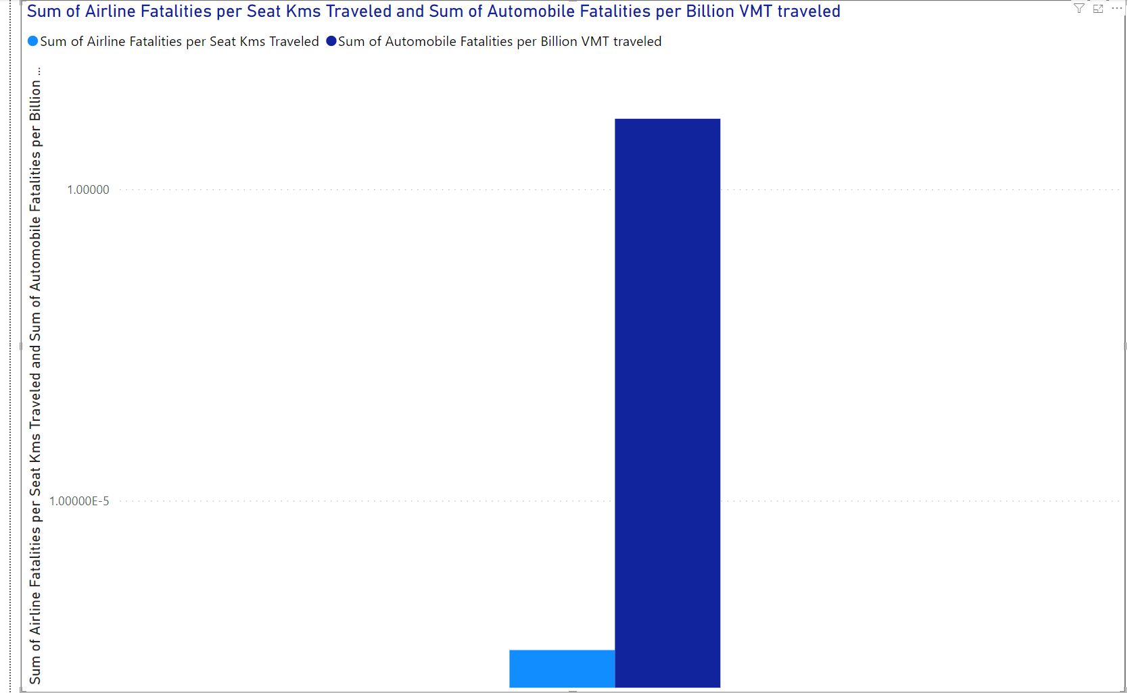
Airline Fatality vs Automobile Fatality
The number of airline fatalities are very less compared to Automobile Fatalities
Notes:
After consulting a variety of sources, you will need to narrow your topic. For example, the topic of internet safety is huge, but you could narrow that topic to include internet safety in regards to social media apps that teenagers are using heavily. A topic like that is more specific and will be relevant to your peers. Some questions to think about to help you narrow your topic:
What topics of the research interest me the most?
What topics of the research will interest my audience the most?
What topics will the audience find more engaging? Shocking? Inspiring?

Slide 6
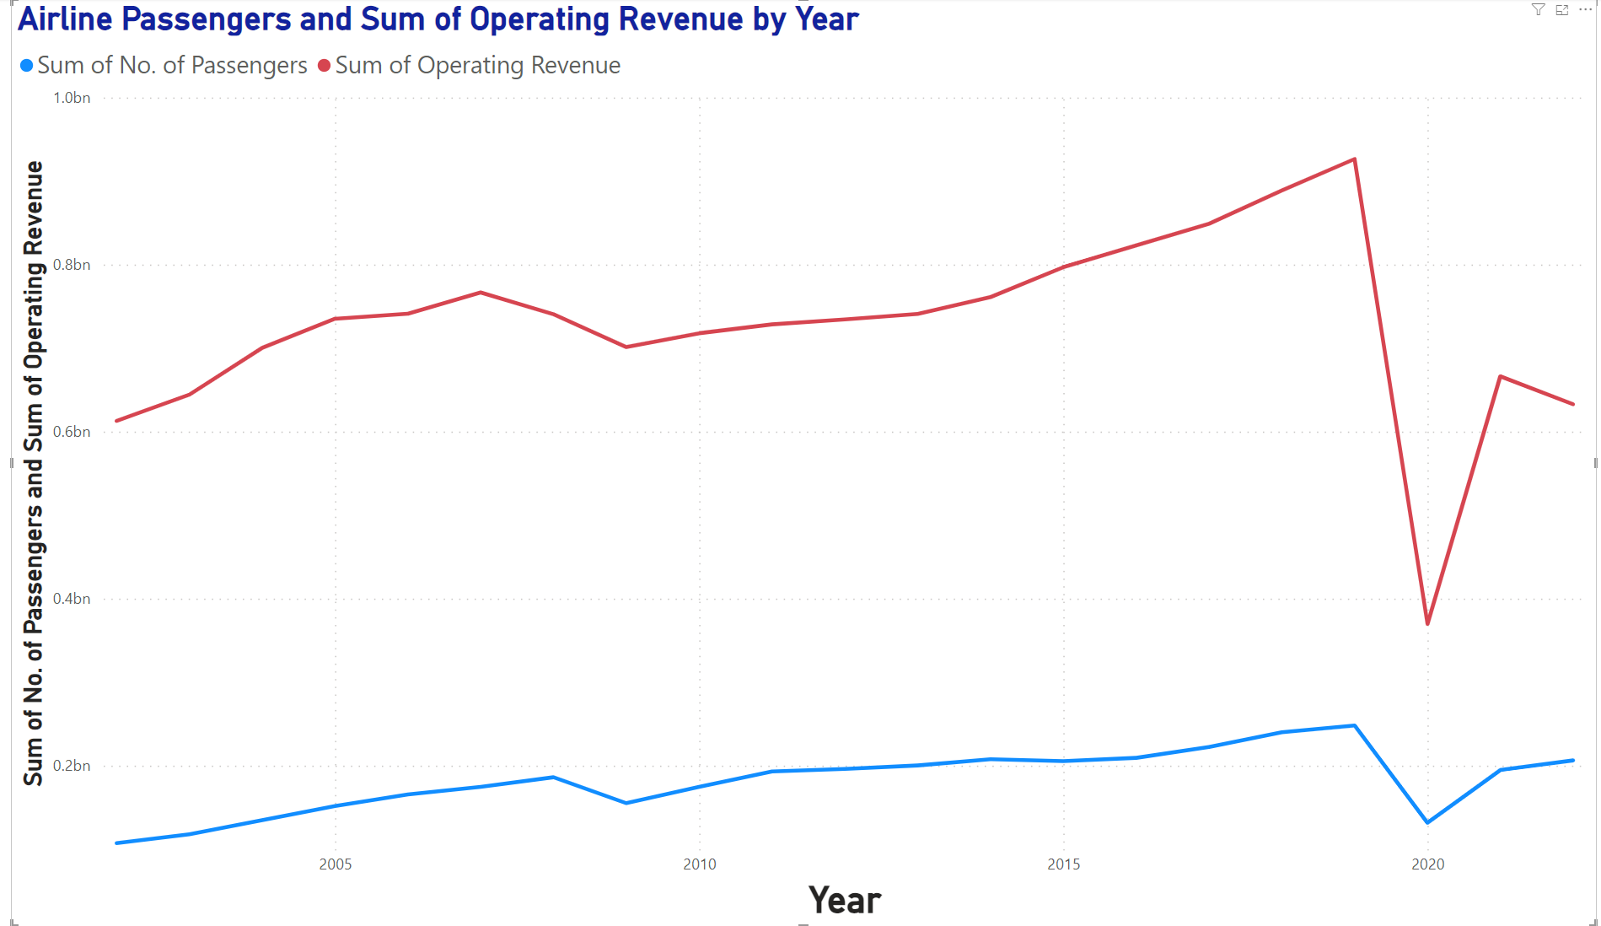
Airline Revenue over years
Revenue and the number of passengers travelling in airline have increased over the years

Slide 7



Conclusion
Air travel is safer than auto travel
Air travel has gotten safer over time
Notes:
You can use this slide as your opening or closing slide. Should you choose to use it as a closing, make sure you review the main points of your presentation. One creative way to do that is by adding animations to the various graphics on a slide. This slide has 4 different graphics, and, when you view the slideshow, you will see that you can click to reveal the next graphic. Similarly, as you review the main topics in your presentation, you may want each point to show up when you are addressing that topic.
Add animation to images and graphics:
Select your image or graphic.
Click on the Animations tab.
Choose from the options. The animation for this slide is “Split”. The drop-down menu in the Animation section gives even more animations you can use.
If you have multiple graphics or images, you will see a number appear next to it that notes the order of the animations.
Note: You will want to choose the animations carefully. You do not want to make your audience dizzy from your presentation.

Slide 8
References
Fatality facts 2019: Yearly snapshot. IIHS. (n.d.). Retrieved October 9, 2021, from https://www.iihs.org/topics/fatality-statistics/detail/yearly-snapshot.
U.S. Air Carrier Safety Data. U.S. Air Carrier Safety Data | Bureau of Transportation Statistics. (n.d.). Retrieved October 9, 2021, from https://www.bts.gov/content/us-air-carrier-safety-data.
Airline Safety. Retrieved from Github - fivethirtyeight: https://github.com/fivethirtyeight/data/tree/master/airline-safety
Operating Revenue (In Thousands of Dollars) Retrieved from Bureau of Transportation Statistics: https://www.transtats.bts.gov/Data_Elements_Financial.aspx?Data=7
Passengers All U.S. Carriers - All Airports. Retrieved from Bureau of Transportation Statistics: https://www.transtats.bts.gov/Data_Elements.aspx?Data=1

Slide 9

THANK YOU

